Slide 1
Saving the Earth
Made by:
Karla Kamenjašević
Nina Jadanec
Josipa Antol
Danijela Ronta
Nikola Jadanec

Slide 2
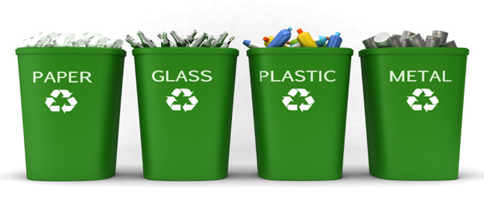
Tip 1:
Recycle!

Slide 3
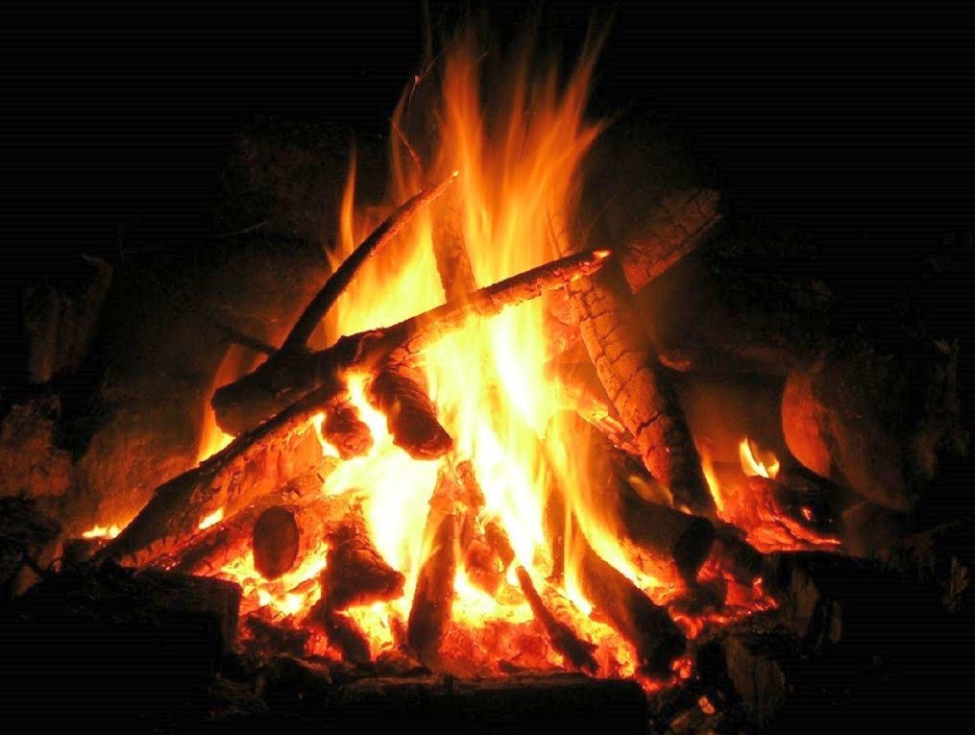
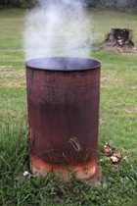
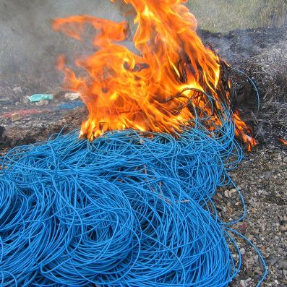
Tip 2:
Don’t burn harmful things!

Slide 4
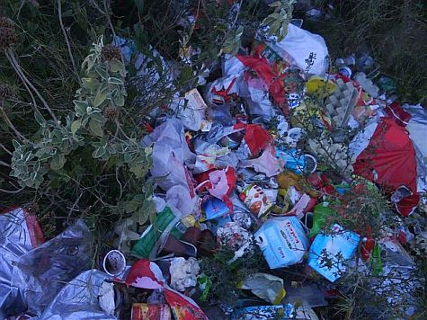
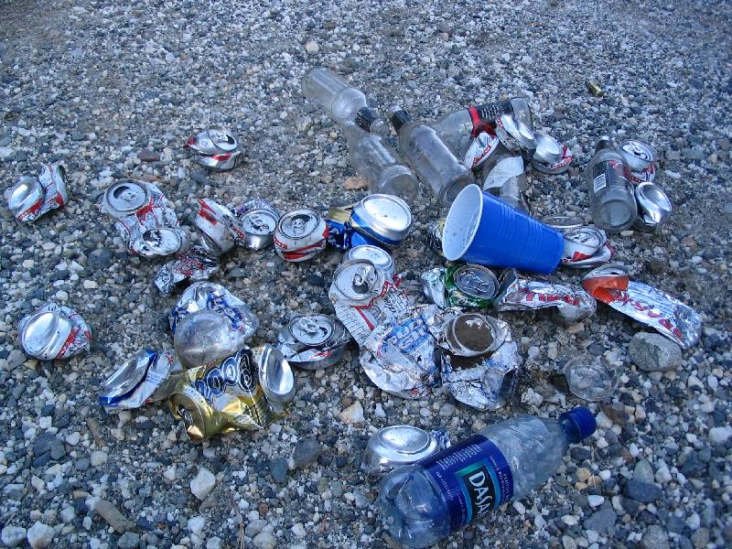
Tip 3:
Leave no trace of your visit in nature!

Slide 5
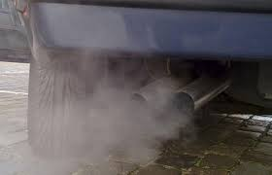
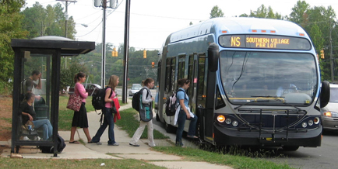
Tip 4:
Use public transportation to reduce air pollution!

Slide 6
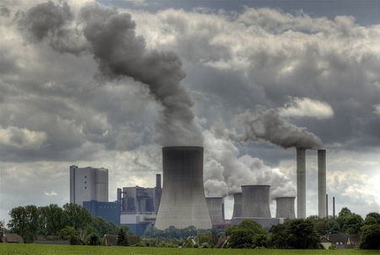
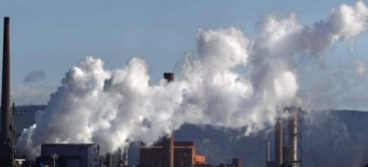
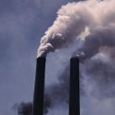
Tip 5:
Use filters in industry to avoid air pollution!

Slide 7
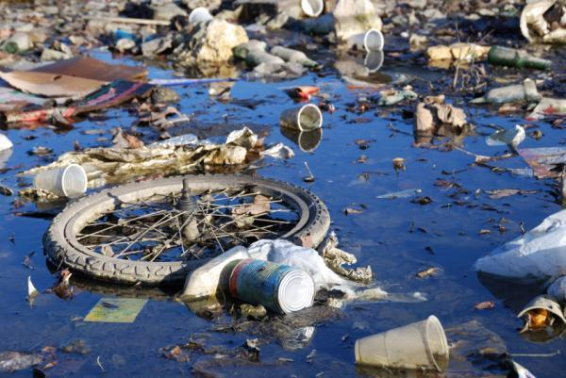
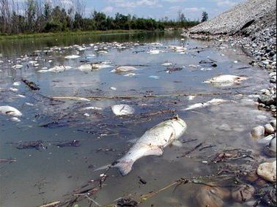
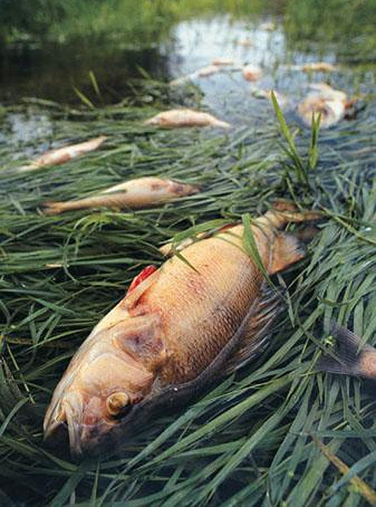
Tip 6:
Don’t pollute water!

Slide 8
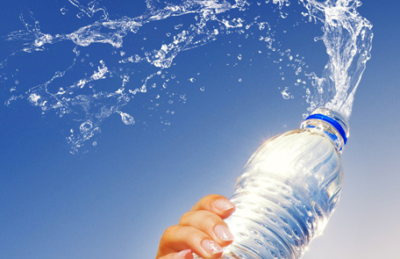
Tip 7:
Use water rationally!

Slide 9
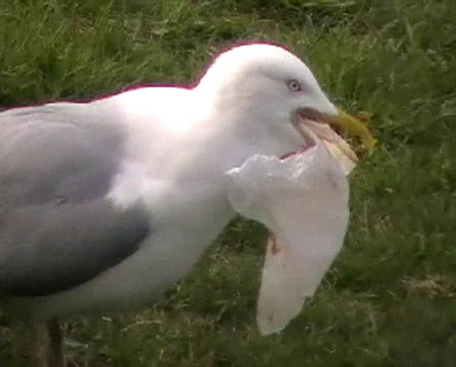
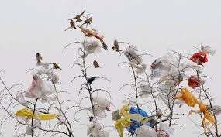
Tip 8:
Ban plastic bags!

Slide 10
Thanks for watching!

